Slide 2

Topics
The if Statement
The if-else Statement
Comparing Strings
Nested Decision Structures and the if-elif-else Statement
Logical Operators
Boolean Variables

Slide 3
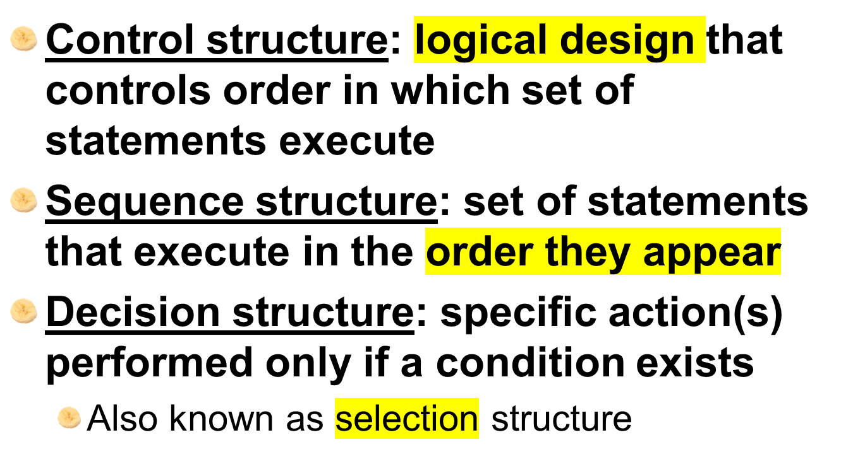
The if Statement

Slide 4
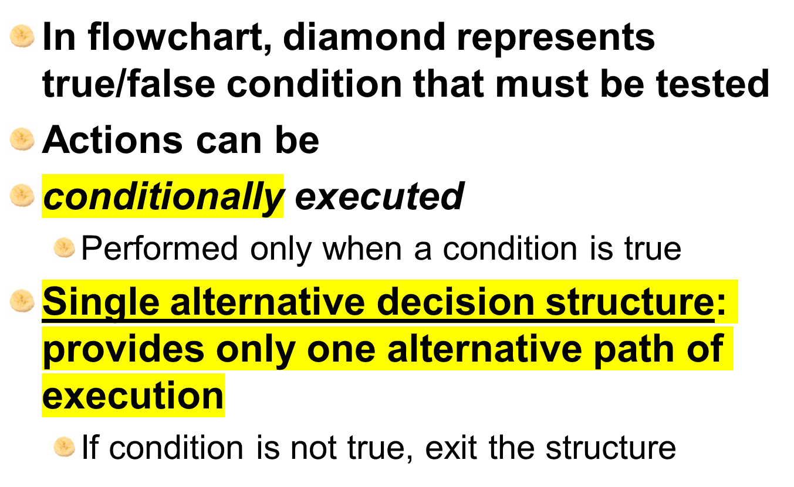
The if Statement (cont’d.)

Slide 5
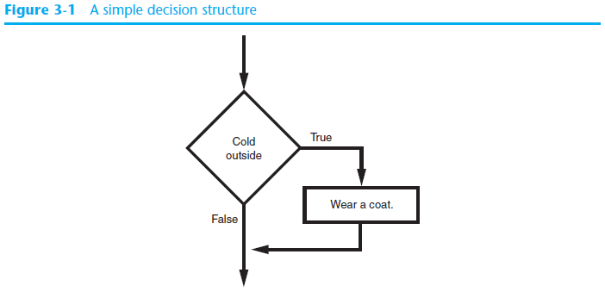
The if Statement (cont’d.)

Slide 6
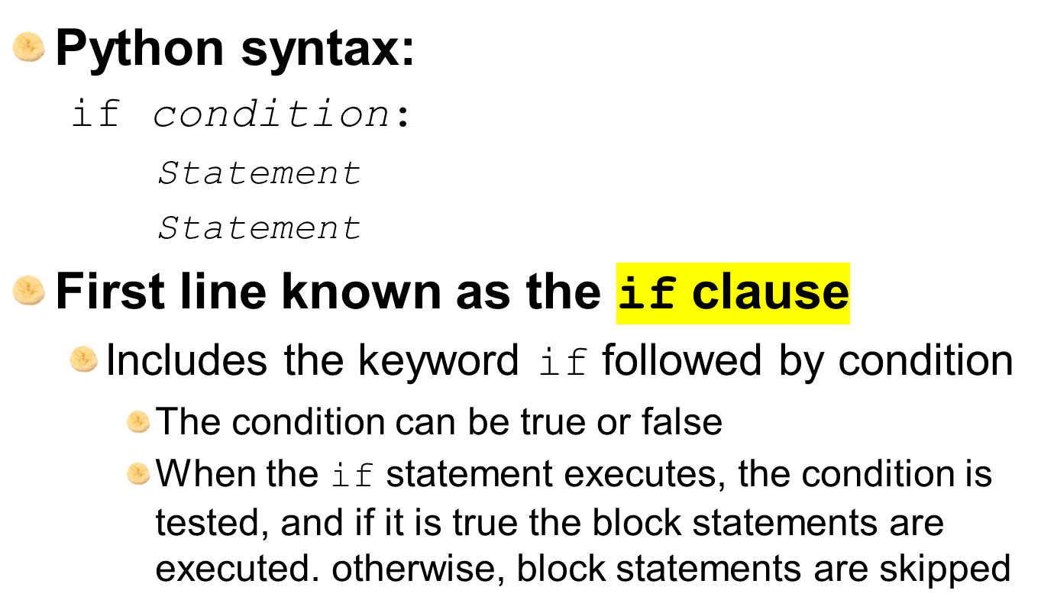
The if Statement (cont’d.)

Slide 7
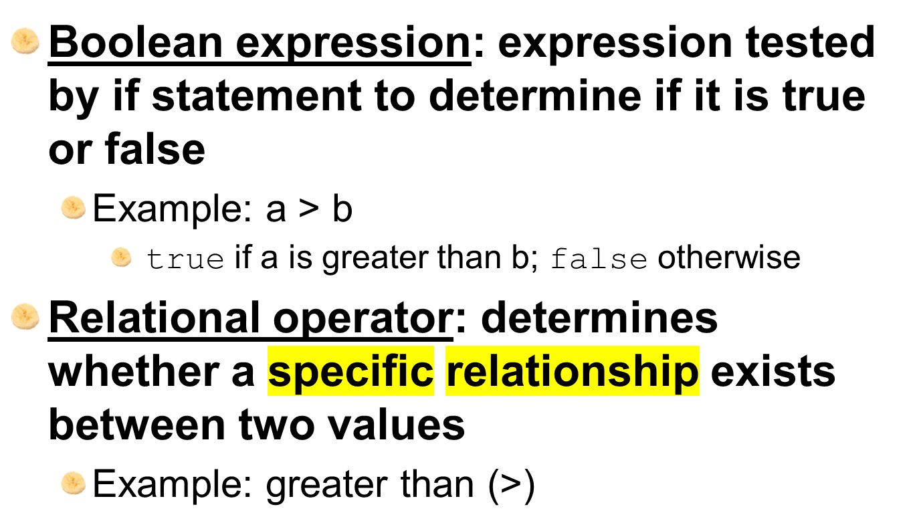
Boolean Expressions and Relational Operators

Slide 8
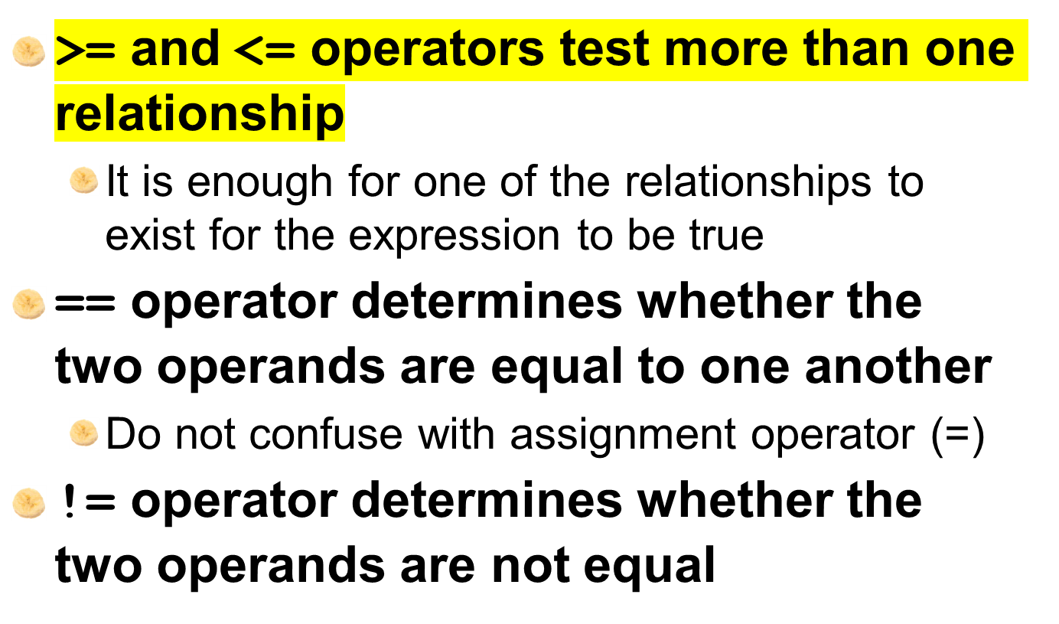
Boolean Expressions and Relational Operators (cont’d.)

Slide 9
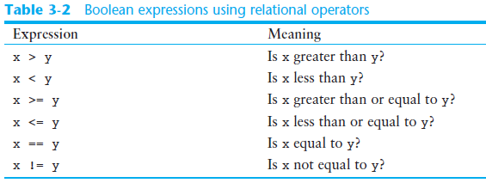
Boolean Expressions and Relational Operators (cont’d.)

Slide 10
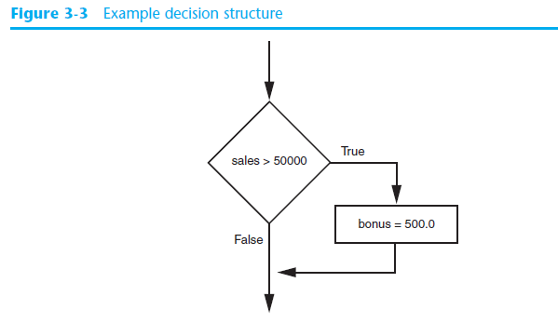
Boolean Expressions and Relational Operators (cont’d.)
Using a Boolean expression with the > relational operator

Slide 11
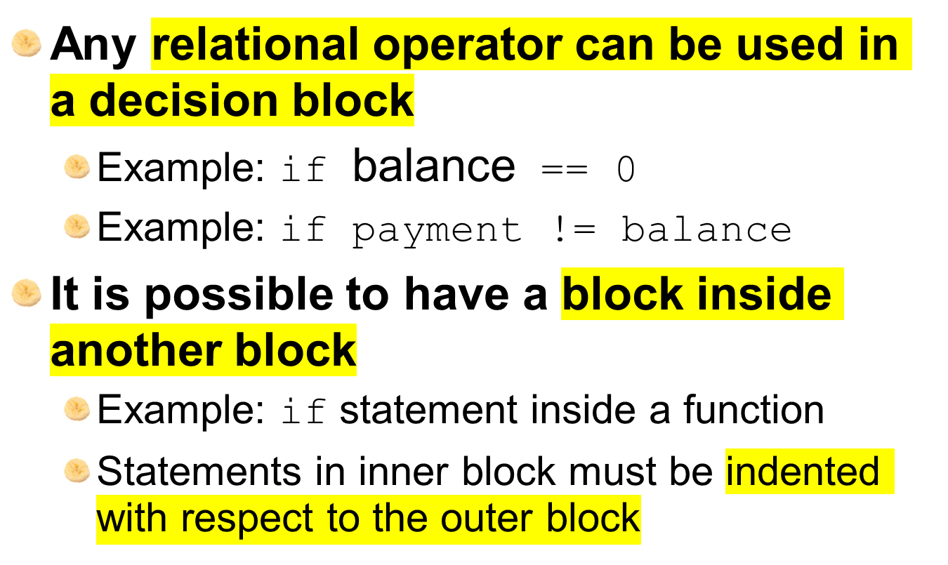
Boolean Expressions and Relational Operators (cont’d.)

Slide 12
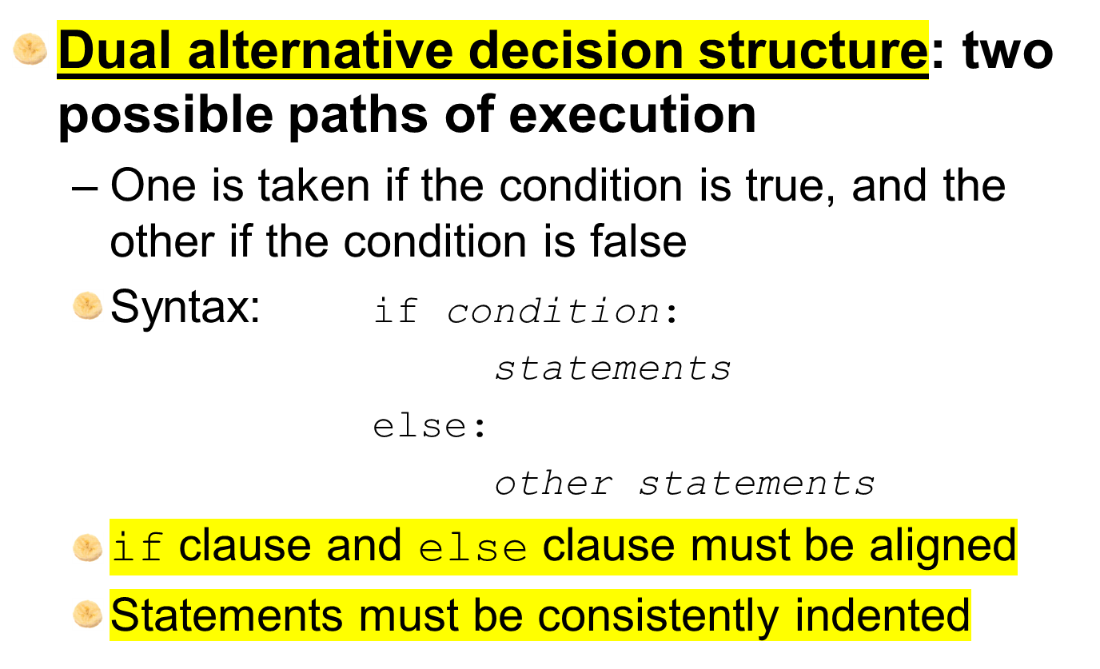
The if-else Statement

Slide 13
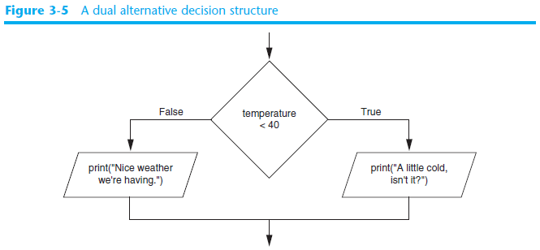
The if-else Statement (cont’d.)

Slide 14
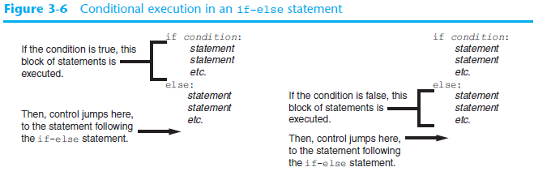
The if-else Statement (cont’d.)

Slide 15
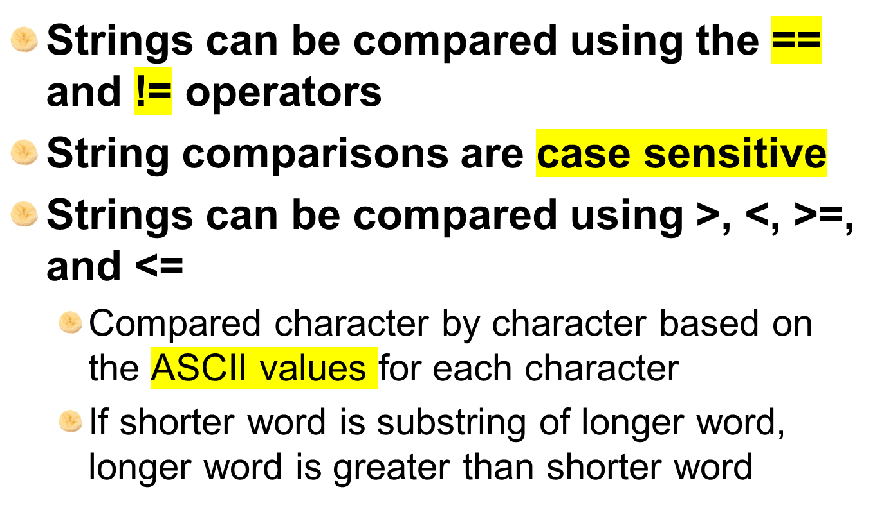
Comparing Strings

Slide 16
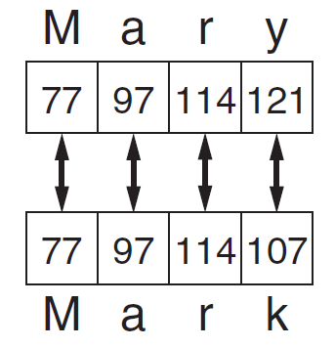
Comparing Strings (cont’d.)

Slide 17

A decision structure can be nested inside another decision structure
  Commonly needed in programs
  Example:
    Determine if someone qualifies for a loan, they must meet two conditions:
      Must earn at least $30,000/year
      Must have been employed for at least two years
    Check first condition, and if it is true, check second condition

Slide 18
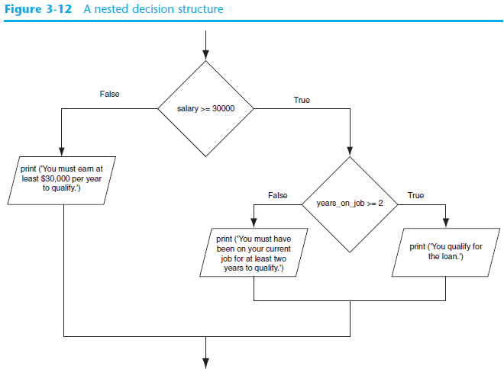

Slide 19
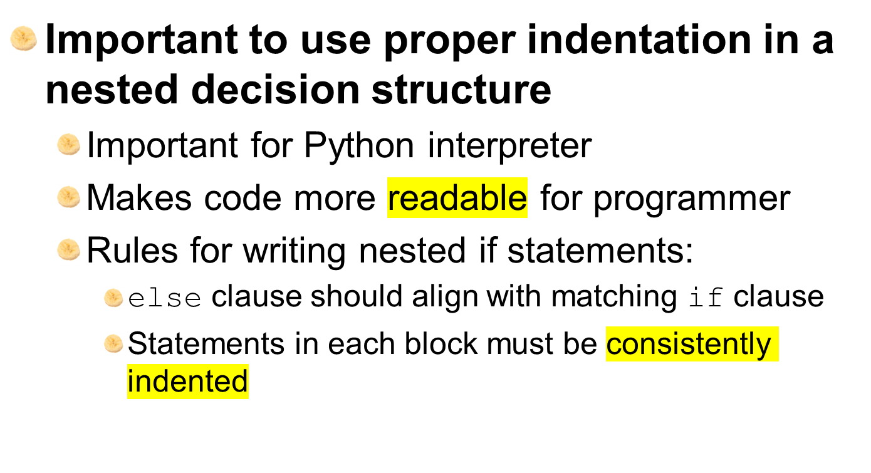
Nested Decision Structures and the if-elif-else Statement (cont’d.)

Slide 20
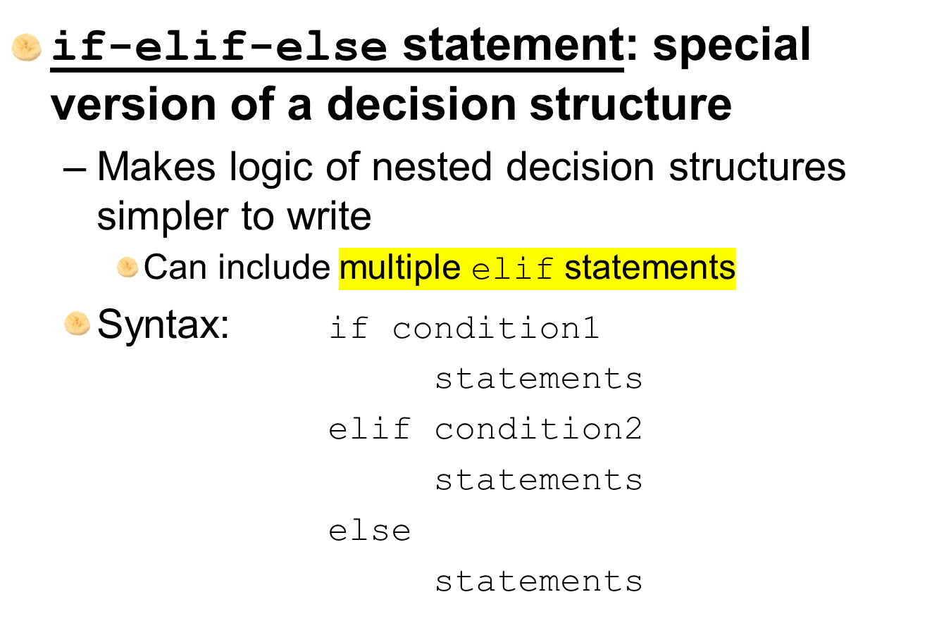
The if-elif-else Statement

Slide 21
The if-elif-else Statement (cont’d.)
Alignment used with if-elif-else statement:
  if, elif, and else clauses are all aligned
  Conditionally executed blocks are consistently indented
if-elif-else statement is never required, but logic easier to follow
  Can be accomplished by nested if-else
    Code can become complex, and indentation can cause problematic long lines

Slide 22
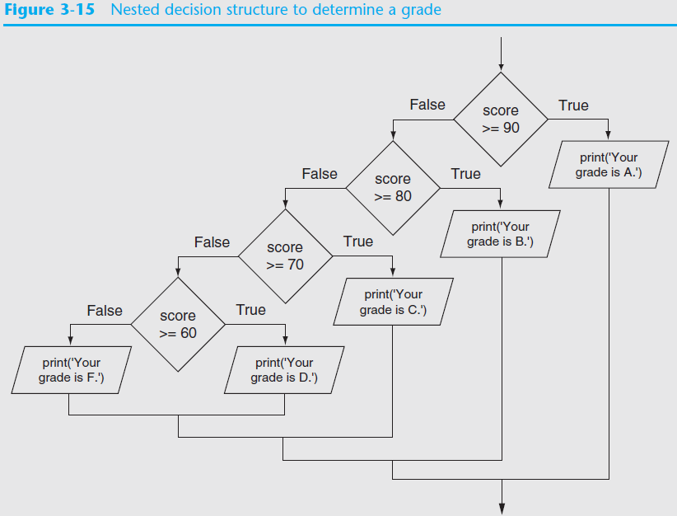

Slide 23
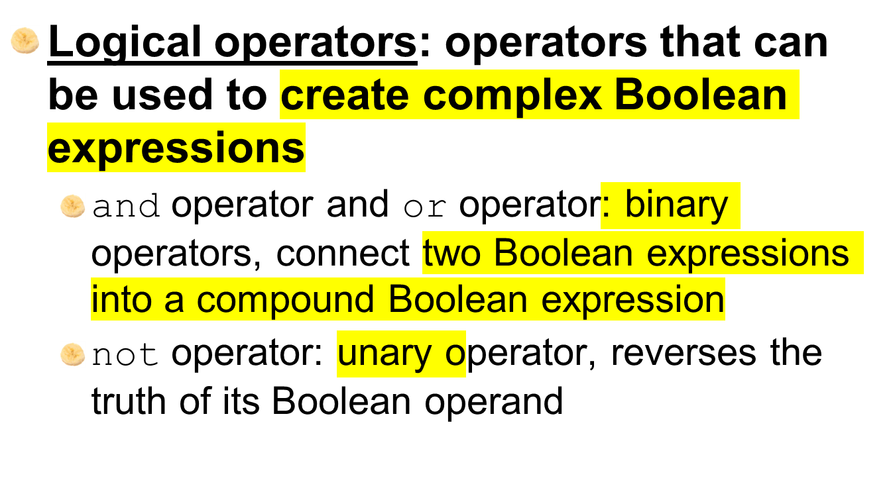
Logical Operators

Slide 24
The and Operator
Takes two Boolean expressions as operands
  Creates compound Boolean expression that is true only when both sub expressions are true
  Can be used to simplify nested decision structures
Truth table for
the and operator
Expression | Value of the Expression
false and false | false
false and true | false
true and false | false
true and true | true

Slide 25
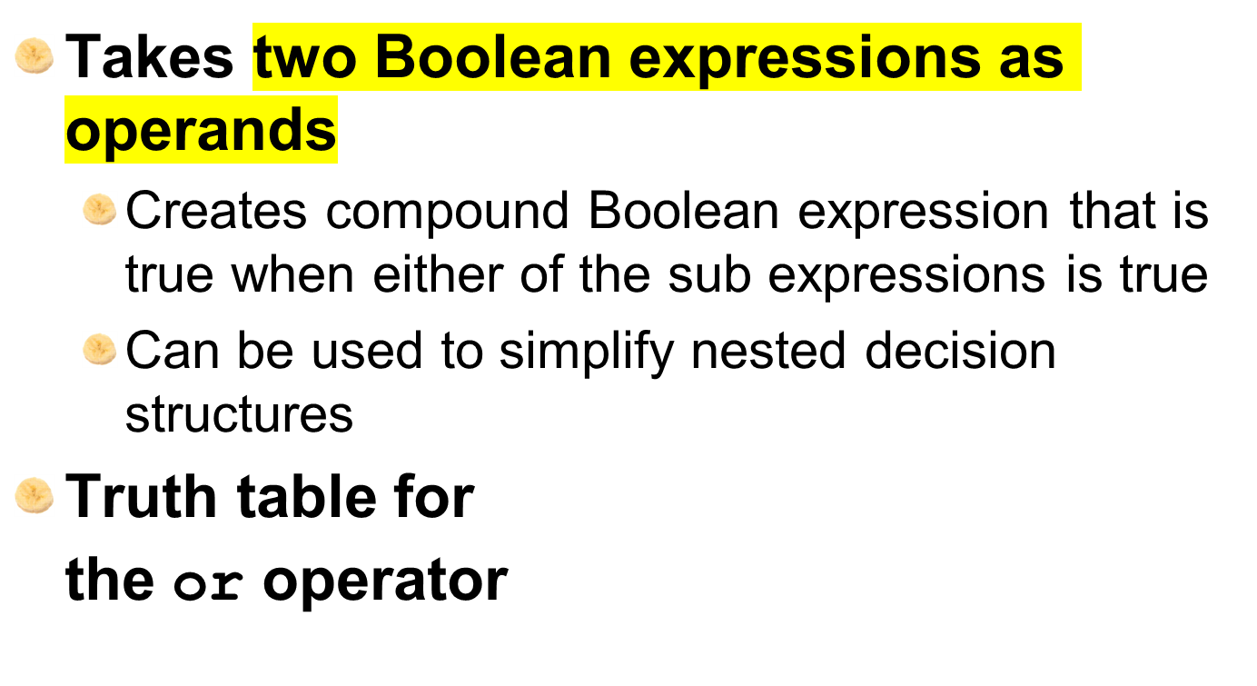
The or Operator
Expression | Value of the Expression
false and false | false
false and true | true
true and false | true
true and true | true

Slide 26
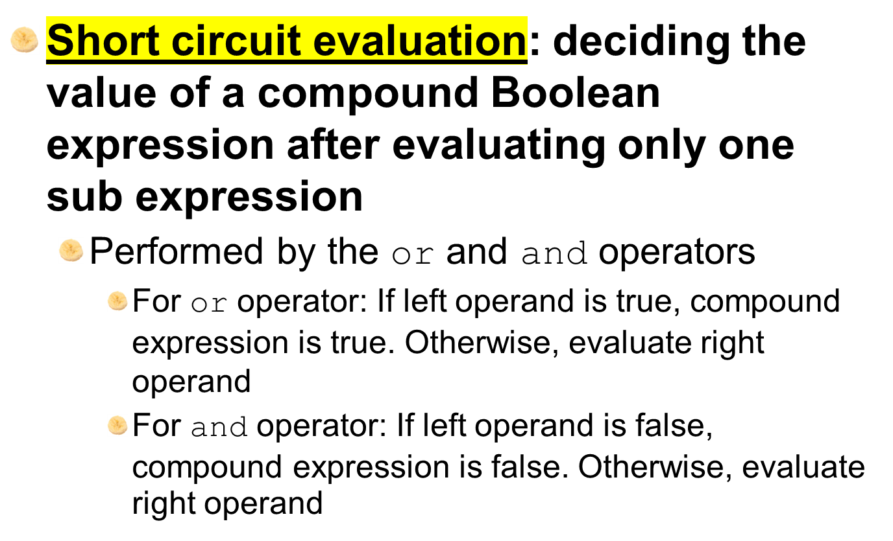
Short-Circuit Evaluation

Slide 27
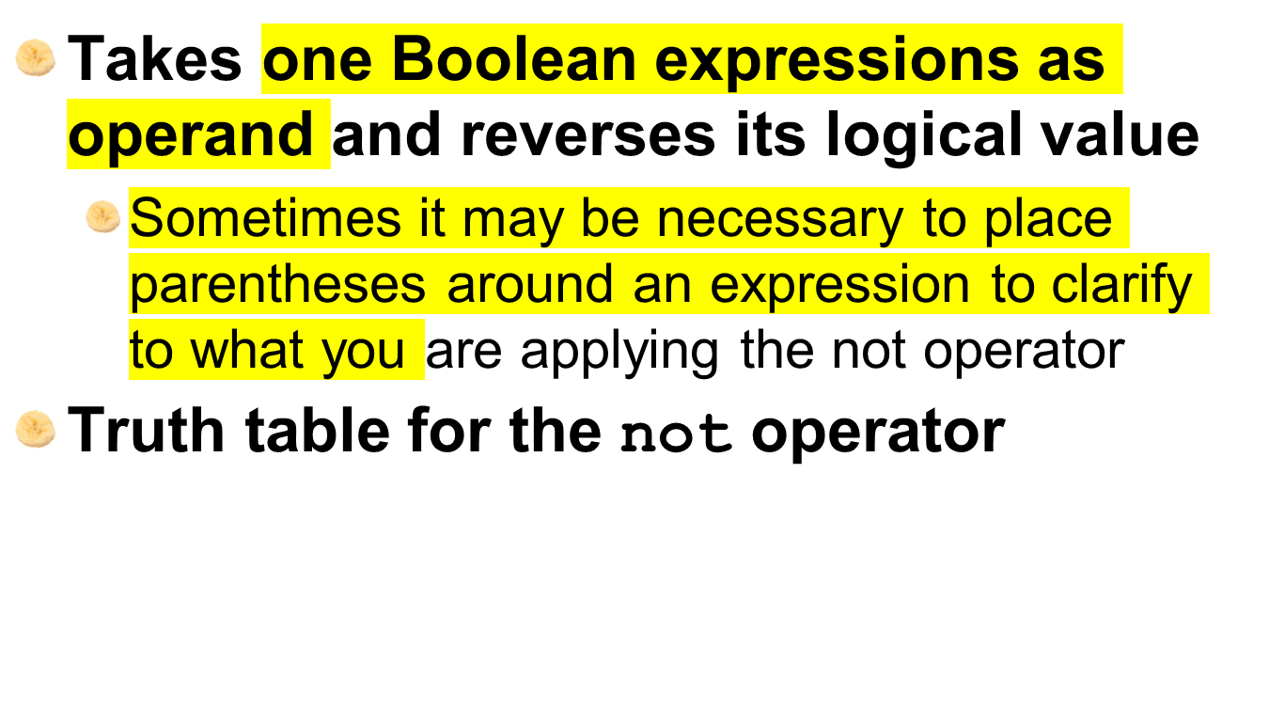
The not Operator
Expression | Value of the Expression
true | false
false | true

Slide 28
Checking Numeric Ranges with Logical Operators
To determine whether a numeric value is within a specific range of values, use and
  Example: x >= 10 and x <= 20
To determine whether a numeric value is outside of a specific range of values, use or
  Example: x < 10 or x > 20

Slide 29
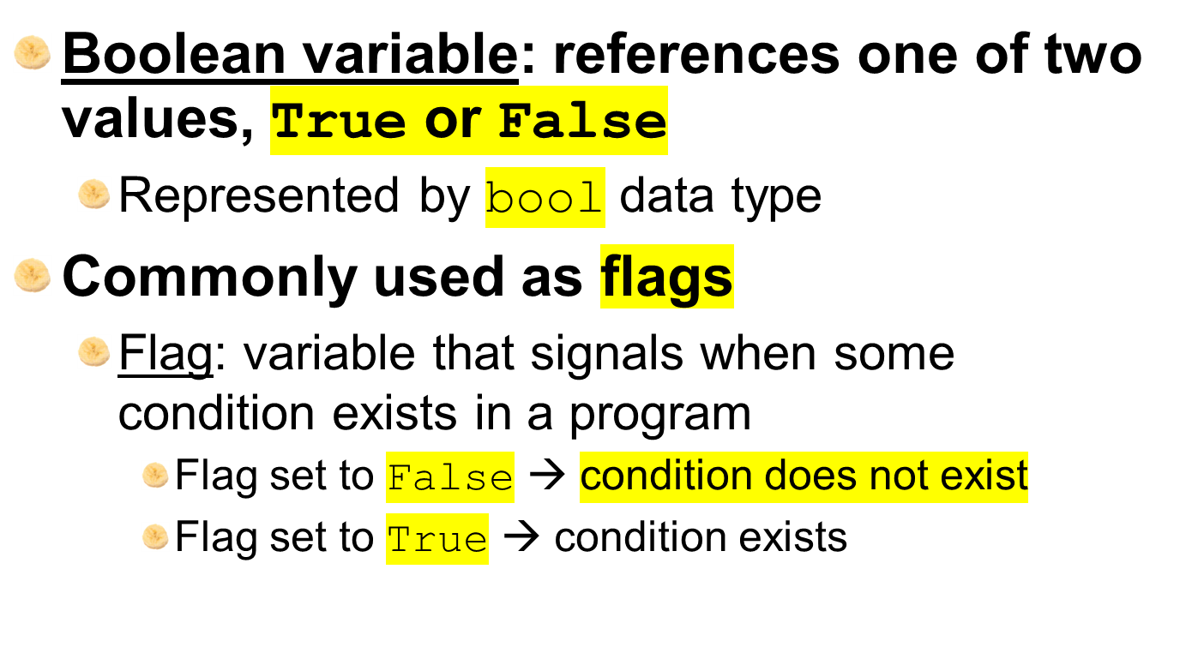
Boolean Variables

Slide 30
Summary
This chapter covered:
  Decision structures, including:
    Single alternative decision structures
    Dual alternative decision structures
    Nested decision structures
  Relational operators and logical operators as used in creating Boolean expressions
  String comparison as used in creating Boolean expressions
  Boolean variables

